Slide 1
INTERNAL ASSESMENT-1
SANJAY RAM C

Slide 2
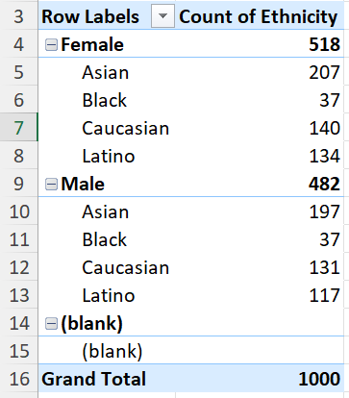
QUESTION-1
Insert gender and ethnicity into rows of a pivot table
Insert ethnicity into column that gives us count of ethnicity for each category
Total no of Asian ethnics in the company are higher followed by Caucasian, Latino. Black ethnics are the least with only 74 employees with 37 from male and female each.

Slide 3
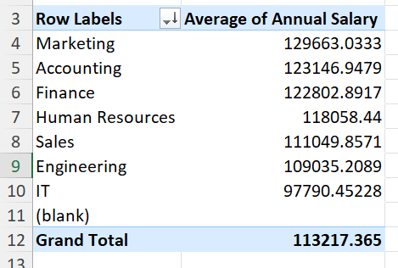
Question-3
From the table it is clearly inferred that there are no significant difference between avg salaries of employees from different departments.

Slide 4
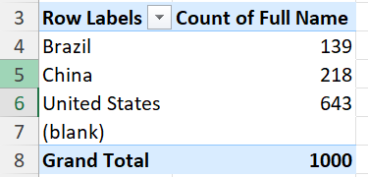

Question-4
Inserting the country column into rows and employee names into column categories of the pivot table would do the work.
From the image, it is clearly observed that United states has highest no of employees with 643 followed by China and Brazil.

Slide 5
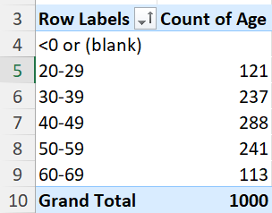
Question-5
Inserting the age column in both the rows and columns of the pivot table would do the work.
In the age column, we have to group the data in such a way that it shows the age range wise.
From the table, we can clearly infer that the common age range of employees working in this company are from 40-49 with 288 employees.

Slide 6
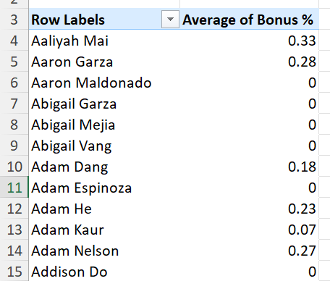

Question-6
Insert the bonus% into the pivot table and find the average of the bonus %.
The first table shows the average bonus% of each employee.
From the second table, it is clearly inferred that the avg of bonus% for all the employees is 0.08866%.

Slide 7
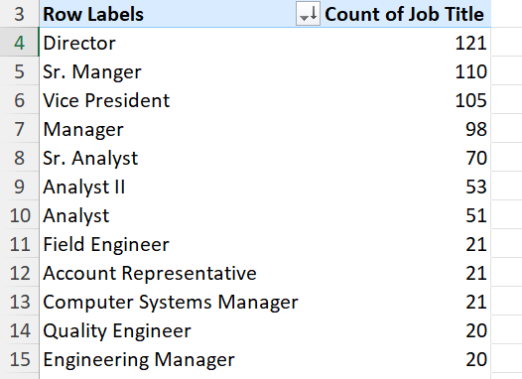

Question-7
Insert the job titles into the pivot table rows to find the count of each job title.
From the table, we can sort the job titles using top10 filter and it is clear that the Director job title occurs frequently in the data with 121 entries.

Slide 8
Question-8
Work-life balance, the hike problem or any internal conflicts

Slide 9
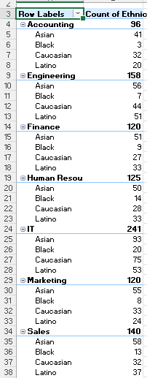
Question-9
From observing the table beside, each department is not diverse in terms of ethnicity as black ethnicity is less in all the departments.
We can see that few departments like IT,Human resourse and Sales are comparitvely diverse to a little extent in terms of ethnicity.

Slide 10
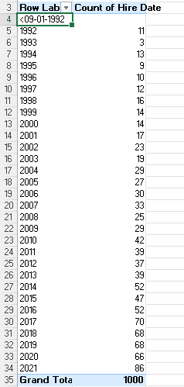
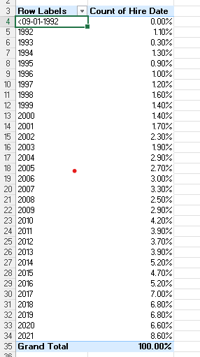
Question-10
For the past few years, the count of hires has been on and off
The no of employees hired from 2015 to 2021 has been constantly increasing and decreasing.
In the year 2021, the company has hired many employees(86).

